Slide 1
Modern Systems Analysis and Design Eighth Edition, Global Edition Joseph S. Valacich Joey F. George
Managing the Information Systems Project

Slide 2
Learning Objectives
Explain the process of managing an information systems project, including project initiation, project planning, project execution, and project closedown,
Describe how to represent and schedule project plans using Gantt charts and network diagrams, and
Explain how commercial project management software packages can be used to assist in representing and managing project schedules

Slide 3
Introduction
Project management (PM) may be the most important aspect of systems development.
Effective PM helps to ensure
The meeting of customer expectations.
The satisfying of budget and time constraints.
The nature of projects has changed from custom development to implementing packaged software such as ERP and data warehousing.
PM needs to be able to work well with vendors and diverse user community.

Slide 4
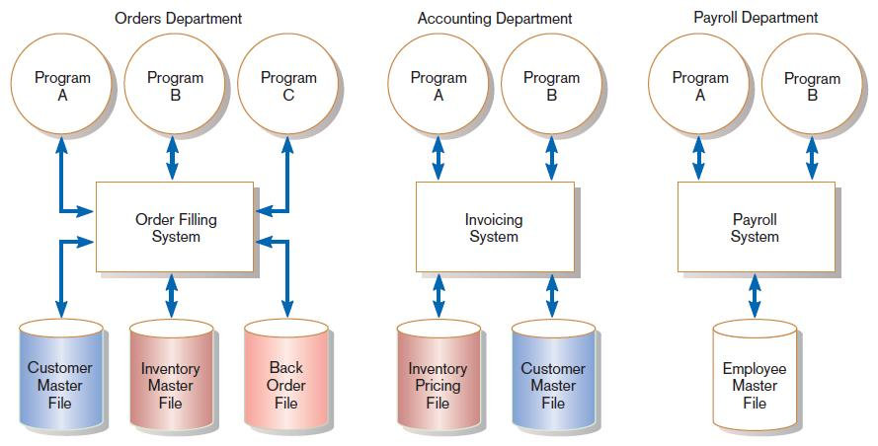
Pine Valley Application Project
FIGURE 3-1
Three computer applications at Pine Valley Furniture: order filling, invoicing, and payroll
(Source: Hoffer, Ramesh, and Topi, Modern Database Management 11th ed. 2013)
Notes:
This chapter includes several examples related to PVF, a furniture manufacturing company. This figure shows PVF’s information system prior to creating a centralized database.
Throughout this chapter, we’ll see discussion of a few projects at PVF.

Slide 5
Managing the Information Systems Project
Project
A planned undertaking of related activities to reach an objective that has a beginning and an end
Project management
A controlled process of initiating, planning, executing, and closing down a project

Slide 6
Managing the Information Systems Project (cont.)
Project manager
A systems analyst with a diverse set of skills—management, leadership, technical, conflict management, and customer relationship—who is responsible for initiating, planning, executing, and closing down a project
Deliverable
The end product of an SDLC phase
Notes:
The project manager needs to have both technical and organizational skills, and should be a good communicator with a strong sense of time management.
Each SDLC phase will have some deliverable. Planning’s deliverable is typically a feasibility report, a budget, and a preliminary schedule. The Analysis phase usually results in a set of functional requirements. Logical design results in system specifications and physical design delivers actual programs and databases. So, each phase has a deliverable.
We talked about these a bit in chapter 1, and will talk in more detail in future chapters.

Slide 7
Deciding on Systems Projects
System Service Request (SSR)
A standard form for requesting or proposing systems development work within an organization
Feasibility study
A study that determines whether a requested system makes economic and operational sense for an organization
Notes:
A company will often need to consider several potential projects. Not all project requests should be granted. These requests will be prioritized based on importance and feasibility. Typically, a review board judges and approves project requests. At PVF, they call this the Systems Priority Board.
The board evaluates requests based on the business problems or opportunities the system addresses and judges how the proposed project fits within the organization’s information systems architecture and long-range development plans. The board selects the projects that best meet overall organizational objectives.

Slide 8
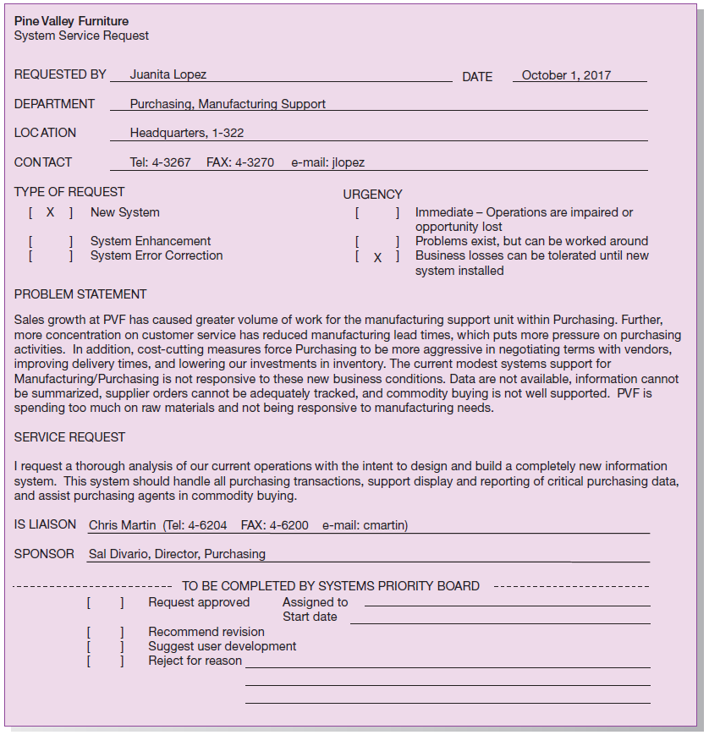
FIGURE 3-2
System Service Request for Purchasing Fulfillment System with name and contact information of the person requesting the system, a statement of the problem, and the name and contact information of the liaison and sponsor
Notes:
Here is the Purchasing Fulfillment System SSR. As you can see, Juanita Lopez identifies a business problem and a requested solution. This is a request for a new system, the biggest level request. The primary beneficiaries will be Purchasing and Manufacturing. Although it is an important project, there is recognition and acceptance that this may be a long-term project, as you can see in the “urgency” section.
Systems development projects are undertaken for two primary reasons: to take advantage of business opportunities and to solve business problems. Taking advantage of an opportunity might mean providing an innovative service to customers through the creation of a new system. Solving a business problem could involve modifying the way an existing system processes data so that more accurate or timely information is provided to users.

Slide 9
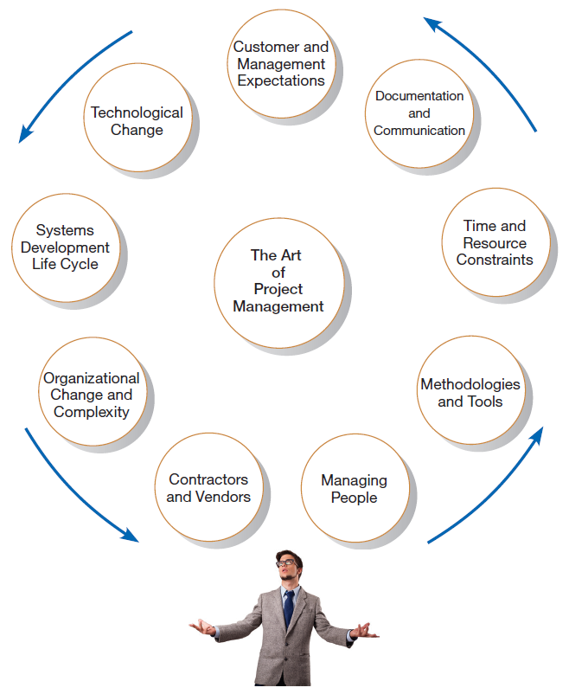
Project Management Activities
FIGURE 3-4
A project manager juggles numerous
activities
Notes:
As you can see, a project manager leads a very busy life, and needs to take into account many factors and stakeholders when making scheduling, resource, and design decisions.

Slide 10
Phases of Project Management Process
Phase 1: Initiation
Phase 2: Planning
Phase 3: Execution
Phase 4: Closedown

Slide 11
PM Phase 1: Project Initiation
Assess size, scope and complexity, and establish procedures.
Establish:
Initiation team
Relationship with customer
Project initiation plan
Management procedures
Project management environment and workbook
Project charter
Notes:
In the case of PVF’s purchasing fulfillment system project, initiation involved these steps:
Juanita observed problems with the existing purchasing system.
She contacted Chris from the IS department to set up an SSR.
The Systems Priority Board at PVF reviewed and approved the project request.
A steering committee was set up to oversee the project.
A detailed project plan was developed and executed.

Slide 12
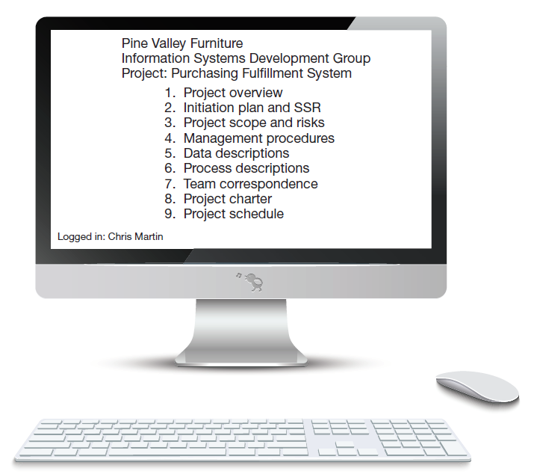
FIGURE 3-6
The project workbook for the Purchasing Fulfillment System project contains nine key elements
Project workbook
An online or hard-copy repository for all project correspondence, inputs, outputs, deliverables, procedures, and standards. Used for performing project audits, orienting new team members, communicating with management and customers, identifying future projects, and performing post-project reviews.
Notes:
The project workbook contains all of the documentation regarding the project. For example, the SSR we saw in a previous slide is contained kept in the workbook.
The project workbook will consist of a bunch of other documents that we’ll look at in the next few slides.

Slide 13
Project Charter
A short document prepared for the customer describing project deliverables and outlining the work required to complete the project
Elements:
Title and authorization date
Project manager name and contact information
Customer name and contact information
Project start and completion dates
Key stakeholders, roles, responsibilities
Project objectives and description
Key assumptions
Signatures of stakeholders
Notes:
The project charter gives a formal expression of the common understanding between the IS project team and the client. Different companies may have different formats for their project charters.
The project charter is another document that goes into the project workbook.

Slide 14
PM Phase 2: Project Planning
Define clear, discrete activities and the work needed to complete each activity. Tasks include:
Describing Project Scope, Alternatives, and Feasibility
Dividing the Project into Manageable Tasks
Estimating Resources and Creating a Resource Plan
Developing a Preliminary Schedule
Developing a Communication Plan
Determining Project Standards and Procedures
Identifying and Assessing Risk
Creating a Preliminary Budget
Developing a Project Scope Statement
Setting a Baseline Project Plan
Notes:
As you can see, project planning involves several different activities. Some of these tasks can be aided with project management software tools, like Microsoft Project. For example, MS Project directly helps with #2, 3, 4, 8, and 10.
We’ll see some MS project screenshots in future slides. These MS Project files will also be part of the project workbook.

Slide 15
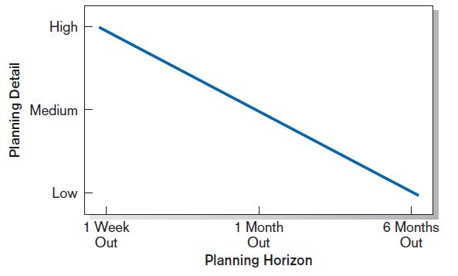
Planning Detail
FIGURE 3-8
Level of project planning detail should be high in the short term, with less detail as time goes on
Notes:
The general principal is that we need to accept the fact of uncertainty, and that things will change over time. So, although we want a detailed idea of what we’re going to do in the immediate future, we allow for more flexibility as time goes on.
This implies that planning is always going on. Plans are revisited and evolve over time.

Slide 16
Project Scope, Alternatives, and Feasibility
What problem or opportunity does the project address?
What are the quantifiable results to be achieved?
What needs to be done?
How will success be measured?
How will we know when we are finished?
Notes:
It’s important to watch out for “scope creep”, where the project requirements grow too much. To avoid this, part of the planning process is to define the expectations ahead of time.

Slide 17
Dividing Project into Manageable Tasks
Work Breakdown Structure (WBS)
Division of project into manageable and logically ordered tasks and subtasks
Scheduling Diagrams
Gantt chart: horizontal bars represent task durations
Network diagram: boxes and links represent task dependencies

Slide 18
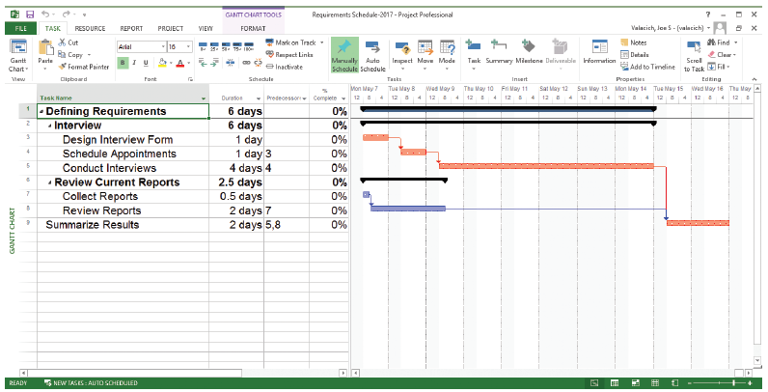
Developing a Preliminary Schedule
WBS
Gantt Chart
FIGURE 3-10
Gantt chart showing project tasks, duration times for those tasks, and predecessors
(Source: Microsoft Corporation.)
Notes:
This is a typical Microsoft Project screen. The left part of this screen is a Work Breakdown Structure (WBS), which shows the hierarchy of tasks, subtasks, sub-subtasks, etc. The boldfaced tasks are summary tasks, and their durations are based on the durations and dependencies of their subtasks. MS Project automatically calculates project duration based on how you set the task durations and dependencies.
The durations and dependencies between these tasks are shown graphically in the Gantt chart to the right. You can use either the WBS of the Gantt chart or both as you set up the project schedule.

Slide 19
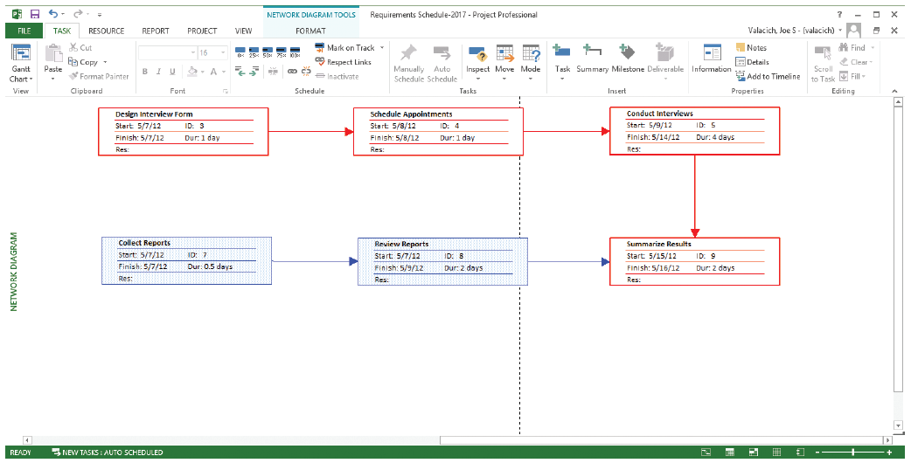
Scheduling Diagrams Network Diagram
FIGURE 3-12
A network diagram illustrating tasks with rectangles (or ovals) and the relationships and sequences of those activities with arrows
(Source: Microsoft Corporation.)
Notes:
This is another screen shot, that shows the tasks in a network diagram. You have different ways of viewing a project.

Slide 20
Estimating Resources, Creating a Resource Plan
Constructive Cost Model (COCOMO) – an automated software estimation model that uses historical project data and current/future project characteristics to estimate project costs
People are the most important and expensive resource
Important to have a good balance between specialization and task variety
Notes:
COCOMO is a commonly used tool in software development projects. It provides an estimate of software costs.
When assigning people to tasks, you want to make sure a person’s talents, skills and interests match well with the tasks that need to be done. Some projects divide people into highly specialized roles, whereas in other projects each person gets a variety of different types of tasks. These are important interpersonal issues that a project manager is faced with.

Slide 21
Developing a Communication Plan
Who are stakeholders?
What information does each stakeholder need?
When should information be produced?
What are sources of information?
Who will collect, store and validate info?
Who will organize and document info?
Who is the contact person for each stakeholder?
What is the appropriate/best format for info?
What communication medium should be used?
Notes:
A large project may affect many groups within and outside the organization. With all these stakeholders, it is important to create and execute a workable and efficient plan for keeping everyone in the loop.

Slide 22
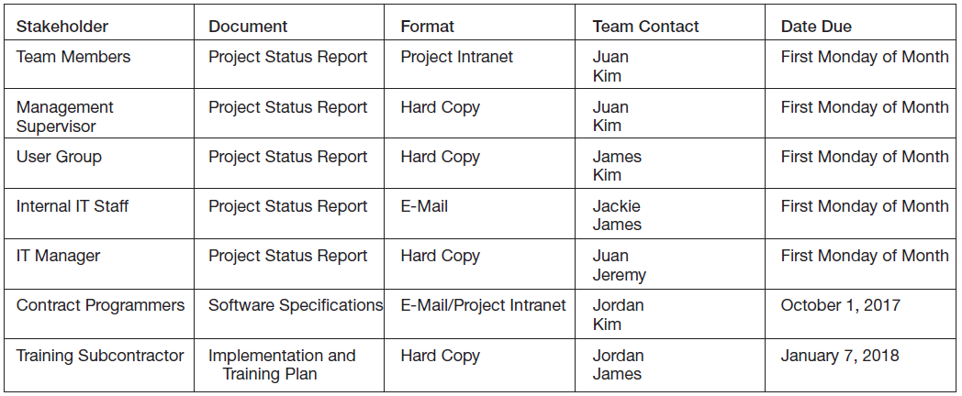
Communication Plan
FIGURE 3-13
The project communication matrix
provides a high-level summary of the
communication plan
Notes:
This grid is a good expression of the communication plan. And it would be another document to add to the project workbook.

Slide 23
Determining Project Standards and Procedures
Type of SDLC methodology
Documentation styles
Status updates
Terminology

Slide 24
Identifying and Assessing Risk
Sources of risk
Consequences of risk
Possible sources: new technology, user resistance, critical resource availability, competitive reactions, regulatory changes, team member experience

Slide 25
Developing a Preliminary Budget
FIGURE 3-14
A financial cost and benefit analysis for a systems development project (Source: Microsoft Corporation.)
Spreadsheet software is good for this.
Notes:
Spreadsheet software like Microsoft Excel is often used for budgeting. MS Project also provides a vehicle for budgeting, which is tied to the scheduling and resource allocation parts of the tool.
Obviously, the project budget is another important part of the overall project workbook.

Slide 26
Setting a Baseline Project Plan
A Baseline Project Plan provides an estimate of the project’s tasks and resource requirements and is used to guide the next project phase—execution. As new information is acquired during project execution, the baseline plan will continue to be updated.
Notes:
By “baseline” we mean a standard against which we’ll evaluate the project’s actual progress. The baseline is our prediction. Remember that we talked about uncertainty, which is why the project plan can’t be too detailed for the long-term future. So, it’s not surprising that the baseline plan will be modified as time goes on.
But it gives us a direction by setting goals and expectations, in terms of both time and financial cost.
Microsoft Project includes the capability to set a baseline plan and compare it to actual progress.

Slide 27
PM Phase 3: Project Execution
Plans created in prior phases are put into action.
Actions
Execute baseline project plan.
Monitor progress against baseline plan.
Manage changes in baseline plan.
Maintain project workbook.
Communicate project status.
Notes:
Phase 2 was about planning the project. At phase 3, the activities defined in the project plan are actually tackled by the people (resources) who are assigned these tasks. While the project is being executed, the project manager monitors progress and adjusts plans, resource allocation, etc. accordingly. All the time, new documentation is added to the project workbook, and the communication channels remain open and active.

Slide 28
Monitoring Progress with a Gantt Chart
FIGURE 3-16
Gantt chart with tasks 3 and 7 completed and task 8 partially completed (Source: Microsoft Corporation.)
Red bars indicate critical path; lines through bars indicate percent complete.
Notes:
The red bars are the critical path, which means that these tasks cannot be delayed or lengthened without affecting the overall duration of the project. There is a precise algorithm for calculating the critical path in a project, and we’ll go through this formula shortly. Fortunately, project management tools like Microsoft Project automatically calculate critical paths.
The little black bars inside the blue bars of the Gantt chart show how much of the task is actually completed. So, here we see a case of using MS Project to monitor and track progress during project execution.

Slide 29
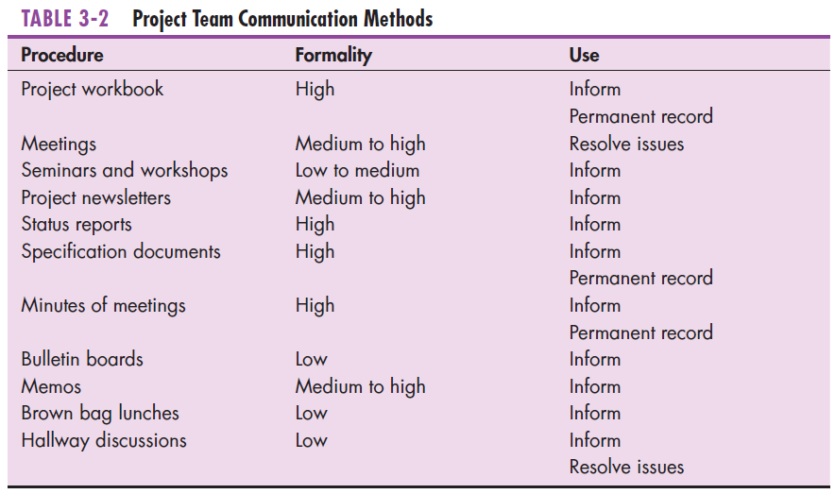
Communication Methods
Notes:
We’ve already talked about the importance of communication, and in the planning phase we discussed the construction of a communication plan. This table shows several different modes of communication that are possible among project stakeholders. Most teams will use multiple of these methods.

Slide 30
PM Phase 4: Project Closedown
Bring the project to an end.
Natural Termination – Completed Successfully
Unnatural Termination – Due to time and money
Actions
Close down the project.
Conduct post-project reviews.
Close the customer contract.
Notes:
At some point in time, the project ends. These are the three main activities of this final phase.
Closing the project involves reassigning team members to other jobs, assessing team member performance, notifying stakeholders that project has ended, and celebrating team accomplishments.
It’s important to perform post project reviews in order to benefit from reflecting on “lessons learned”. Sometimes this is called a postmortem review.
It’s important to get the agreement that the terms of the SSR have been met and the contract is complete.

Slide 31
Representing and Scheduling Project Plans
Gantt Charts
Network Diagrams
PERT Calculations
Critical Path Scheduling
Project Management Software
Notes:
We’ve already seen a few screen shots of Gantt charts and network diagrams. In the following slides, we delve a little deeper into the calculations that take place when creating project schedules.

Slide 32
Gantt Charts vs. Network Diagrams
Gantt charts
Show task durations.
Show time overlap.
Show slack time in duration.
Network diagrams
Show task dependencies.
Do not show time overlap, but show parallelism.
Show slack time in boxes.
Notes:
Each type of chart has its advantages. You may want to flip from one to another.

Slide 33
Gantt Charts vs. Network Diagrams (Cont.)
Figure 3-18
Graphical diagrams that depict project plans
(a) A Gantt chart
(b) A network diagram
(Source: Microsoft Corporation.)
Notes:
Here they are in Microsoft Project.

Slide 34
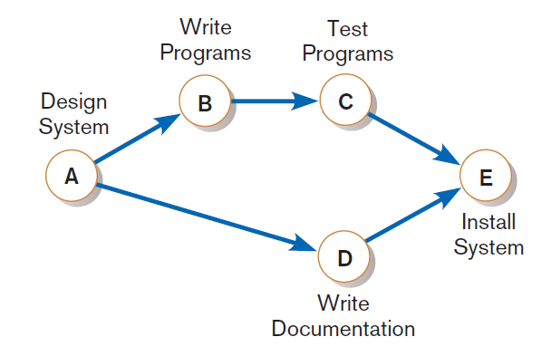
Gantt Charts vs. Network Diagrams (Cont.)
Figure 3-20
A network diagram showing activities
(represented by circles) and sequence of
those activities (represented by arrows)
Notes:
This diagram notation will be used in future slides as we manually go through the critical path calculation. This diagram shows that task D can take place at the same time that B and C are going. But B needs to complete before C can begin. And, both C and D must be completed in order for E to begin.

Slide 35
Estimating Task Duration
PERT: Program Evaluation Review Technique
Technique that uses optimistic (o), pessimistic (p), and realistic (r) time estimates to determine expected task duration
Formula for Estimated Time:
ET = (o + 4r + p)/6
Notes:
This is a simple formula to estimate the time for a task based on our “optimistic”, “realistic”, and “pessimistic” judgments. Each of the detailed tasks in a project can be estimated this way.

Slide 36
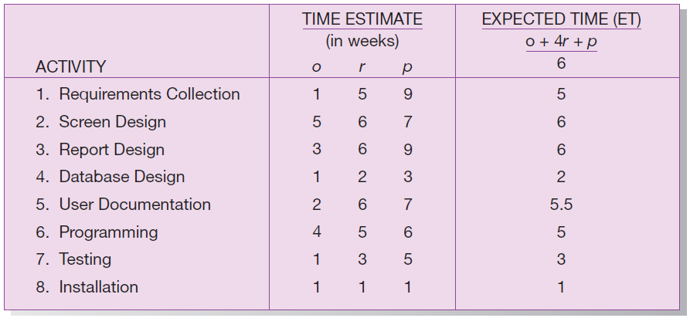
Example PERT Analysis
FIGURE 3-21
Estimated time calculations for the SPTS project
Notes:
This is a PERT analysis of the main tasks of the sales promotion tracking system project. These time estimates are based on previous experience and educated guesses. As a project manager gets more experience in more projects, he or she will get better at estimating the time it takes to complete common tasks. The project workbook helps with this, because it keeps track of history, which can then be used for making future predictions and decisions.

Slide 37
Critical Path Scheduling
A scheduling technique whose order and duration of a sequence of task activities directly affect the completion
Critical path: the shortest time in which a project can be completed
Slack time: the time an activity can be delayed without delaying the project
Notes:
The critical path is determined by the task durations and task dependencies in the project. A project will always have at least one critical path.

Slide 38
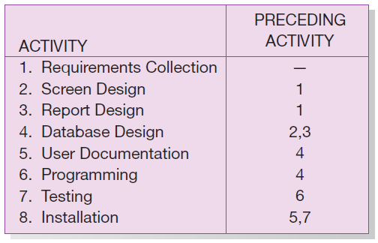
Critical Path Example (dependencies between tasks)
PRECEDING ACTIVITIES indicate the activities that must be completed before the specified activity can begin.
FIGURE 3-22 Sequence of Activities within the SPTS project
Notes:
Here we see, for each task, the tasks that need to be completed before it can begin. As you can see, database design does not begin until screen and report design are both completed.

Slide 39
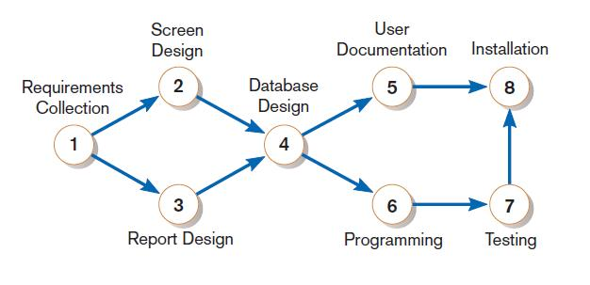
Critical Path Example (Cont.)
Network diagram shows dependencies
FIGURE 3-24
A network diagram that illustrates the activities (circles) and the sequence (arrows) of those activities
Notes:
This network diagram illustrates the dependencies that were shown in the previous slide.
Note that the start task is 1. The end task is 8. There are several paths from 1 to 8:
1,2,4,5,8
1,2,4,6,7,8
1,3,4,5,8
1,3,4,6,7,8
Which one is the critical path?

Slide 40
Determining the Critical Path
Calculate the earliest possible completion time for each activity by summing the activity times in the longest path to the activity. This gives total expected project time.
Calculate the latest possible completion time for each activity by subtracting the activity times in the path following the activity from the total expected time. This gives slack time for activities.
Critical path contains no activities with slack time.
Notes:
The key here is to determine slack time. Tasks that are not on the critical path may have some slack time, but no task on the critical path has any slack time. The critical path identifies the “bottleneck” in the project.

Slide 41
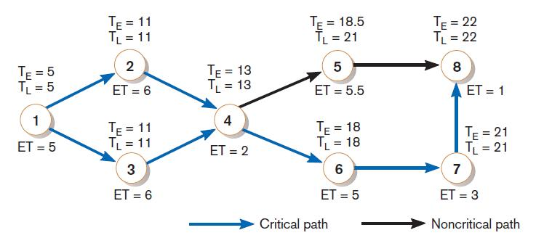
Critical Path Calculation
FIGURE 3-25
A network diagram for the SPTS project showing estimated times for each activity and the earliest and latest expected completion time for each activity
Early and late time calculations are determined and critical path established. (Note: Activity #5 can begin late without affecting project completion time.)
Notes:
The time estimates here are based on the PERT analysis from before.
You can see that the task with slack is 5 (user documentation). That makes sense, because this happens while 6 and 7 happen. The total expected duration for user documentation (task 5) is 5.5weeks whereas the total duration for programming and testing (tasks 6 and 7) is eight weeks. So, task 5 has slack and is therefore not in a critical path.
It turns out that there are two critical paths:
1,2,4,6,7,8
1,3,4,6,7,8
This was a very simple example. A real project may have dozens or even hundreds of tasks, so it’s good to have an automated way of calculating the critical path.

Slide 42
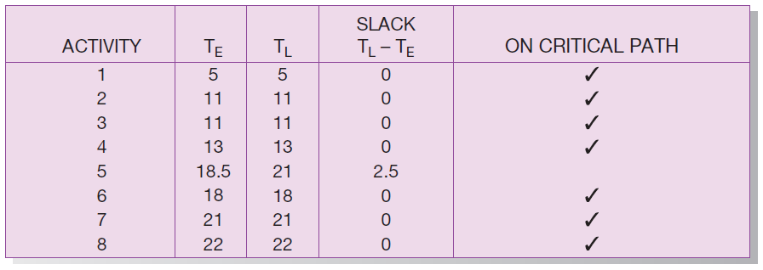
Critical Path Calculation (cont.)
FIGURE 3-26
Activity slack time calculations for the SPTS project; all activities except number 5 are on the critical path
Note the slack time in Activity #5.
Notes:
This gives the results of the CP calculation. Once you know of which tasks are critical and which are not, you can use this to make other scheduling and resource allocation decisions.

Slide 43
Critical Path Calculation (cont.)
Determining Critical Path and Calculating Float (Slack) by using forward and backward pass method
9
4
2
7
4
E
G
H
C
D
Start
8
4
3
End
F
B
A
EF = ES + duration – 1 (For forward pass)
LS = LF – duration + 1 (For backward pass)
Notes:
This gives the results of the CP calculation. Once you know of which tasks are critical and which are not, you can use this to make other scheduling and resource allocation decisions.

Slide 44
Critical Path Calculation (cont.)
9
4
2
7
4
E
20
5
13
G
14
17
H
18
19
C
26
D
1
4
Start
8
4
3
End
12
F
B
5
13
16
A
1
3
EF = ES + duration – 1 (For forward pass)
LS = LF – duration + 1 (For backward pass)
Notes:
This gives the results of the CP calculation. Once you know of which tasks are critical and which are not, you can use this to make other scheduling and resource allocation decisions.

Slide 45
Critical Path Calculation (cont.)
9
4
2
7
4
E
17
18
5
13
G
H
C
14
19
20
26
4
D
1
5
13
14
17
18
19
20
26
1
4
Start
8
4
3
End
F
B
5
12
13
16
A
1
3
6
13
23
26
3
5
EF = ES + duration – 1 (For forward pass)
LS = LF – duration + 1 (For backward pass)
Notes:
This gives the results of the CP calculation. Once you know of which tasks are critical and which are not, you can use this to make other scheduling and resource allocation decisions.

Slide 46
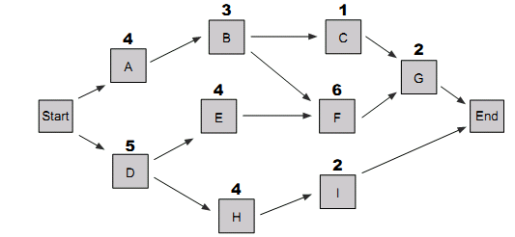
Critical Path Calculation (cont.)
Determining Critical Path and Calculating Float (Slack) for the following diagram.
Notes:
This gives the results of the CP calculation. Once you know of which tasks are critical and which are not, you can use this to make other scheduling and resource allocation decisions.

Slide 47
Using Project Management Software
Many powerful software tools exist for assisting with project management.
Example: Microsoft Project can help with
Entering project start or end date.
Establishing tasks and task dependencies.
Viewing project information as Gantt or Network diagrams.
Notes:
The next couple slides show other Microsoft Project features for some common project management tasks.

Slide 48
Project Start Date
FIGURE 3-27
Establishing a project starting date in Microsoft Project for Windows
(Source: Microsoft Corporation.)
Notes:
MS project allows you to specify all the task dependencies and durations, and then to change the start date if you want, which will result in a different end date for the project (as well as different dates for each of its tasks). You can also instead specify a hoped-for end date in order to determine the latest that a project can start,

Slide 49
Entering Tasks
FIGURE 3-29
Entering tasks and assigning task relationships in Microsoft project
for Windows (Source: Microsoft Corporation.)
Notes:
In the work breakdown structure on the left, you can see many properties of each task in the project plan. Here, we see duration, start and finish dates, and predecessors. There are many other properties you could see if you wanted, and there are a variety of WBS “themes”.

Slide 50
Summary
In this chapter you learned how to:
explain the process of managing an information systems project, including project initiation, project planning, project execution, and project closedown,
describe how to represent and schedule project plans using Gantt charts and network diagrams, and
explain how commercial project management software packages can be used to assist in representing and managing project schedules

